Slide 1
Legal Issues in Cloud Computing
By
Tabinda Ali Shah Zaman

Slide 2
Legal Issues in Cloud Computing
Data Privacy: Cloud computing raises concerns about data privacy as users may not have direct control over the physical storage of their data. Ensuring compliance with data protection regulations becomes crucial to safeguard user information.
Liability: Determining liability in case of data breaches or service disruptions is complex in cloud computing. Clear contractual agreements and service-level agreements (SLAs) are essential to define responsibilities and mitigate legal risks.

Slide 3
Legal Issues in Cloud Computing
Copyright: Cloud computing involves the storage and processing of data, raising concerns about copyright infringement. Users and providers need to address copyright issues related to data ownership, sharing, and usage within the cloud environment.
Data Portability: Ensuring data portability between different cloud service providers is a significant concern. Users must have the ability to transfer their data seamlessly, avoiding vendor lock-in and promoting interoperability.

Slide 4
Legal Issues in Cloud Computing
Law and Jurisdiction: Cloud services often operate across multiple jurisdictions, creating challenges in defining applicable laws and jurisdiction in case of legal disputes. Establishing clear legal frameworks becomes essential to address cross-border legal issues.

Slide 5
Challenges in Cloud Computing

Slide 6
Challenges in Cloud Computing
Cost: Managing cloud computing costs can be challenging due to the dynamic nature of resource usage. Organizations need effective cost-monitoring strategies to optimize expenses and prevent unexpected financial burdens.
Portability: Ensuring seamless data and application portability across different cloud environments is a challenge. Avoiding vendor lock-in and enabling easy migration between cloud platforms require careful planning and standardization.

Slide 7
Challenges in Cloud Computing
Reliability: While cloud services aim for high availability, occasional service outages can impact business operations. Achieving consistent reliability requires redundancy measures, backup strategies, and robust disaster recovery plans.
Service Quality: Maintaining consistent service quality is crucial for user satisfaction. Cloud providers need to meet performance expectations, offer scalable solutions, and provide responsive customer support to ensure a positive user experience.

Slide 8
Challenges in Cloud Computing
Downtime: Unplanned downtime, whether due to system failures or maintenance activities, can disrupt operations. Minimizing downtime through effective planning, redundancy, and failover mechanisms is essential for business continuity.
Performance: Achieving optimal performance in the cloud can be challenging, especially with fluctuating workloads. Fine-tuning resource allocation, optimizing configurations, and employing performance monitoring tools are key to enhancing cloud performance.

Slide 9
Challenges in Cloud Computing
Security: Cloud security concerns include data breaches, unauthorized access, and compliance issues. Implementing robust security measures, encryption, access controls, and regular audits are critical for safeguarding sensitive information.
Data Privacy: Cloud computing involves storing and processing vast amounts of data, raising privacy concerns. Compliance with data protection regulations, transparent privacy policies, and secure data handling practices are essential to maintain user trust.

Slide 10
Cloud Services Models

Slide 11
Cloud Service Models
There are the following three types of cloud service models -
Infrastructure as a Service (IaaS)
Platform as a Service (PaaS)
Software as a Service (SaaS)

Slide 12
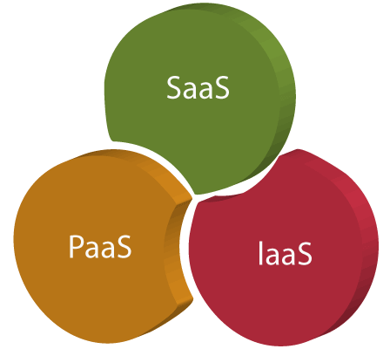

Slide 13
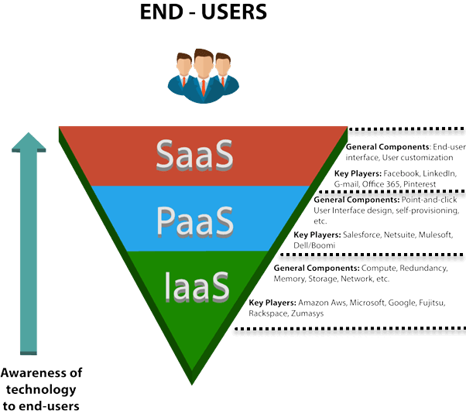

Slide 14
Infrastructure as a Service (IaaS)
IaaS is also known as Hardware as a Service (HaaS). It is a computing infrastructure managed over the internet. The main advantage of using IaaS is that it helps users to avoid the cost and complexity of purchasing and managing the physical servers.
Example: DigitalOcean, Linode, Amazon Web Services (AWS), Microsoft Azure, Google Compute Engine (GCE), Rackspace, and Cisco Metacloud.

Slide 15
Characteristics of IaaS
There are the following characteristics of IaaS -
Resources are available as a service
Services are highly scalable
Dynamic and flexible
GUI and API-based access
Automated administrative tasks

Slide 16
Platform as a Service (PaaS)
PaaS cloud computing platform is created for the programmer to develop, test, run, and manage the applications.
Platform-as-a-Service (PaaS) provides a cloud computing framework for software application creation and deployment. It is a platform for the deployment and management of software apps. This flexible cloud computing model scales up automatically on demand. It also manages the servers, storage, and networking, while the developers manage only the application part. It offers a runtime environment for application development and deployment tools.
Example: AWS Elastic Beanstalk, Windows Azure, Heroku, Force.com, Google App Engine, Apache Stratos, Magento Commerce Cloud, and OpenShift.

Slide 17
Characteristics of PaaS
There are the following characteristics of PaaS -
Accessible to various users via the same development application.
Integrates with web services and databases.
Builds on virtualization technology, so resources can easily be scaled up or down as per the organization's need.
Support multiple languages and frameworks.
Provides an ability to "Auto-scale".

Slide 18
Software as a Service (SaaS)
SaaS is also known as "on-demand software". It is a software in which the applications are hosted by a cloud service provider. Users can access these applications with the help of internet connection and web browser.
Software as a Service (SaaS) is a web-based deployment model that makes the software accessible through a web browser. SaaS software users don’t need to care where the software is hosted, which operating system it uses, or even which programming language it is written in. The SaaS software is accessible from any device with an internet connection.
Example: BigCommerce, Google Apps, Salesforce, Dropbox, ZenDesk, Cisco WebEx, ZenDesk, Slack, and GoToMeeting.

Slide 19
Characteristics of SaaS
There are the following characteristics of SaaS -
Managed from a central location
Hosted on a remote server
Accessible over the internet
Users are not responsible for hardware and software updates. Updates are applied automatically.
The services are purchased on the pay-as-per-use basis

Slide 20
